Slide 1
Dynamic Profiling For Runtime Optimizations
Han Zhang, Jeremy Lacomis

Slide 2
Dynamic Profiling
Collect information at runtime
Likely invariants
Hot loops
Probability of execution
This profiling information can be used to inform optimizations
Notes:
Likely invariants: reduce size of code for static analysis
Hot loops: choose hot functions to further optimize
Probability of execution: choose candidate for expensive optimization during JIT compilation

Slide 3
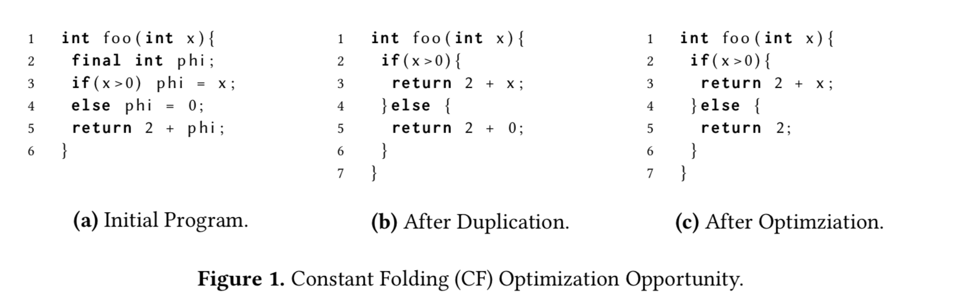
Code Duplication
Duplicating code can enable optimizations:

Slide 4
Code Duplication
Can lead to code bloat
Prohibitive to compute the best possible duplications at runtime
Profiling information can inform which duplicate blocks are most likely to lead to bigger improvements.

Slide 5
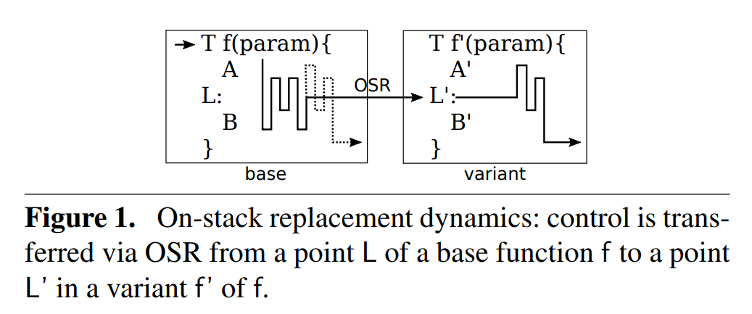
On-Stack Replacement
At runtime, transfer control to a different version of a function using variables already on the stack:

Slide 6
On-Stack Replacement
Transfer to an optimized version of the function (one or more times)
Transfer to a deoptimized version of a function (e.g., speculative assumptions enabled optimizations but no longer hold)
Select best implementation based on the current data
All assumptions aren’t always known statically
Profiling can generate likely invariants and identify expensive functions

Slide 7
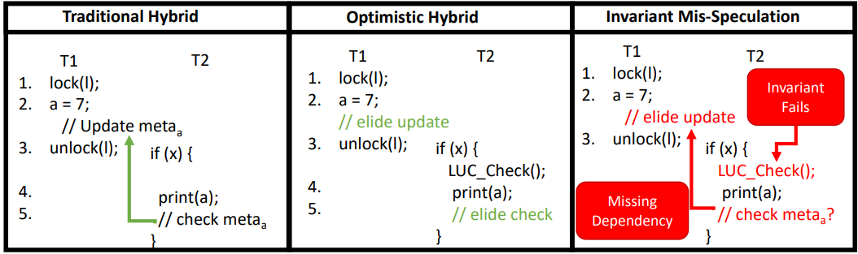
Traditional Hybrid Analysis
Use static analyses to inform dynamic analysis
E.g., FastTrack race detection
Notes:
JEREMY STARTS HERE

Slide 8
Optimistic Hybrid Analysis
Use profiling to collect likely invariants, informing static analyses

Slide 9
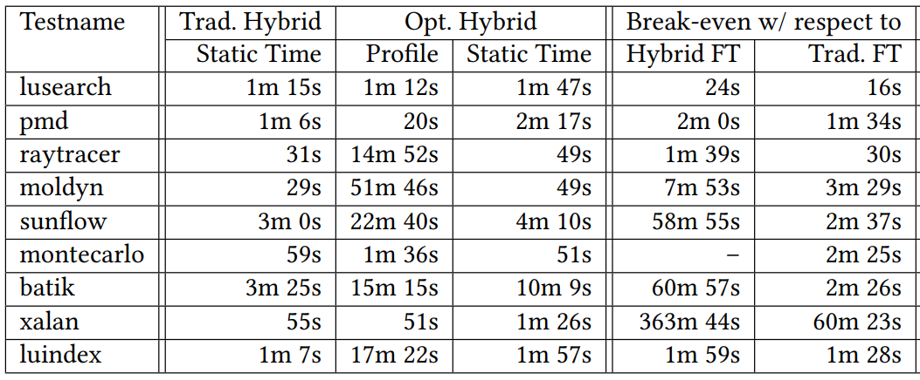
Discussion: Profiling is Expensive

Slide 10
Discussion: Profiling is Expensive

